Slide 1
Nonlinear dimension reduction on head direction circuit
Yusen Zhu
06-27-2020

Slide 2
Outline
Background
Head direction circuit
Isomap and MDS
Methods
Determine topology
Estimate intrinsic manifold dimension
Parameterize manifold
Results
Awake
REM
nREM
Discussion

Slide 3
Outline
Background
Head direction circuit
Isomap and MDS
Methods
Determine topology
Estimate intrinsic manifold dimension
Parameterize manifold
Results
Awake
REM
nREM
Discussion

Slide 4
Head direction circuit
Thalamus, hippocampus, striatum and other areas
This article talk about anterior dorsal thalamic nucleus (ADn)

Slide 5
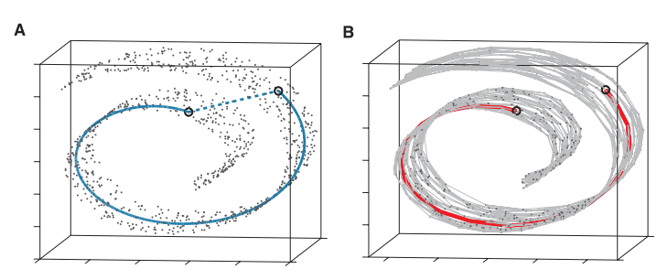
Isomap, MDS
MDS – Minimize strain/ stress, preserve distance
Isomap – Estimate the ‘on manifold’ geodesic distance
By the sum of ‘short hops’, which is the shortest path between two points on the graph. Geometrically it is broken line.
Neighbors are defined by a distance threshold or K nearest neighbors
Cannot deal with rings
[1], figure 3

Slide 6
Outline
Background
Head direction circuit
Isomap and MDS
Methods
Determine topology
Estimate intrinsic manifold dimension
Parameterize manifold
Results
Awake
REM
nREM
Discussion

Slide 7
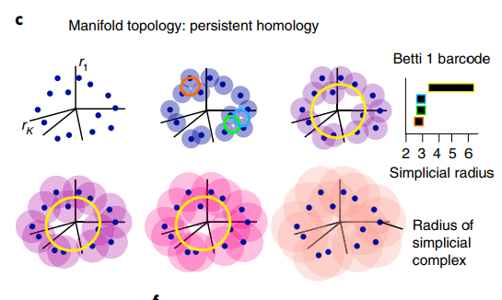
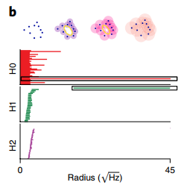
Determine topology
Persistent homology
Detect consistent topological features (Betti code) across blurring radii
Noise model: nt-TDA
Density thresholding

Slide 8
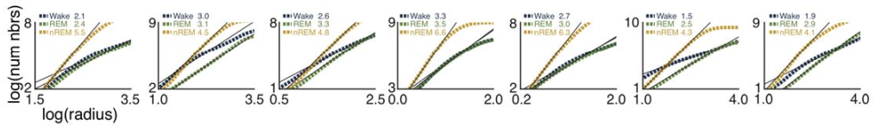
Estimating dimension
Correlation dimension
Count the number of points in a ball of radius r centered at a point on the manifold, as a function of r.
The number of points should grow as rDm if the manifold is Dm dimensional.
Overestimate if r<σ or r>R
Lowered to 10 dimension using Isomap
THIS IS NOT ONE DIMIENSIONAL

Slide 9
Fitting a spline
K means first for nodes
Fit spline
Adjust node
Repeat until converge

Slide 10
Parameterize and projection
Parameterize – distance measurement on spline ring
Normalized to be 2pi
Aligned the origin with behavior
Projection – nearest point on spline

Slide 11
Outline
Background
Head direction circuit
Isomap and MDS
Methods
Determine topology
Estimate intrinsic manifold dimension
Parameterize manifold
Results
Awake
REM
nREM
Discussion

Slide 12
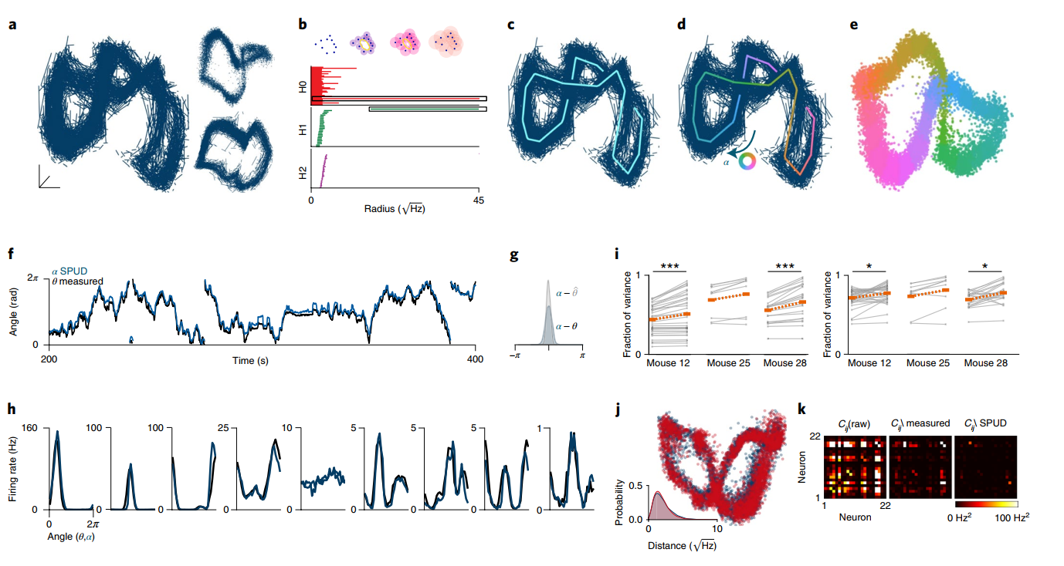
Awake

Slide 13
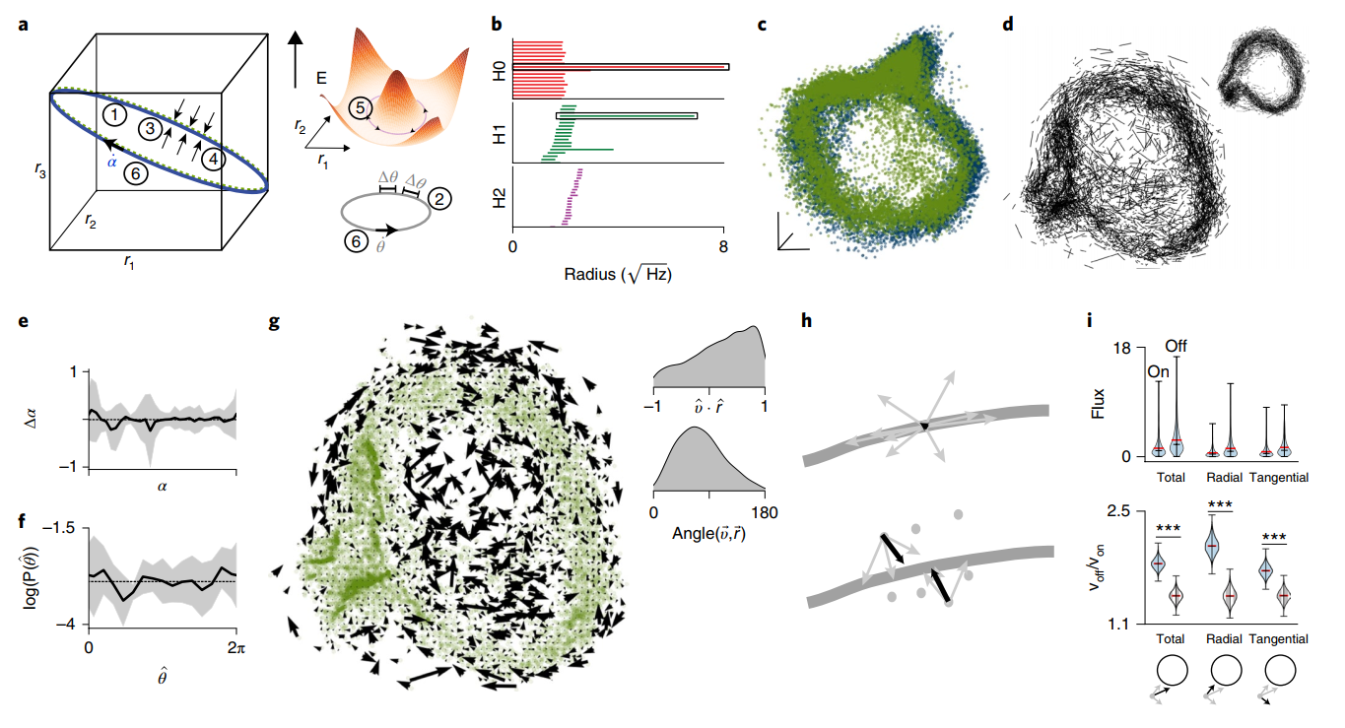
REM

Slide 14
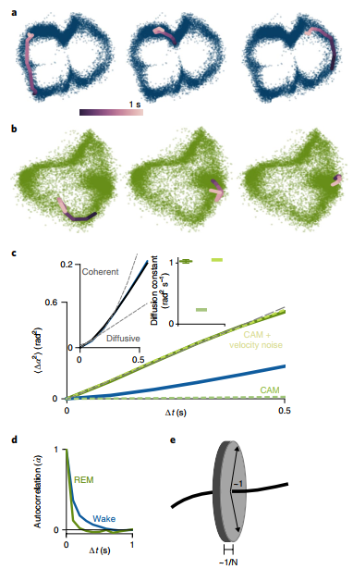
REM diffusion – random walk
Quadratic deflection indicate random walk

Slide 15
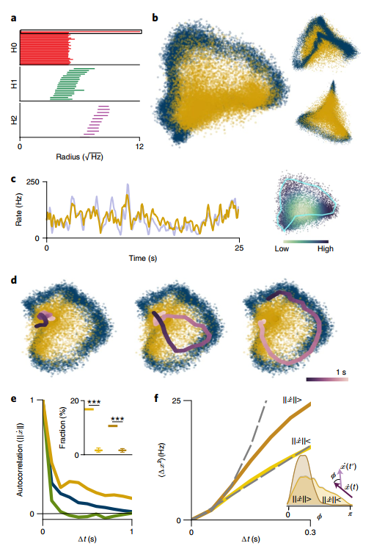
nREM – additional dimension for firing rate
Distance from centroid – firing rate
The rim still fits well to awake and REM

Slide 16
Outline
Background
Head direction circuit
Isomap and MDS
Methods
Determine topology
Estimate intrinsic manifold dimension
Parameterize manifold
Results
Awake
REM
nREM
Discussion

Slide 17
Thanks for listening

Slide 18
Reference
[1] Tenenbaum, Joshua B., Vin De Silva, and John C. Langford. "A global geometric framework for nonlinear dimensionality reduction." science 290.5500 (2000): 2319-2323.
[2] Chaudhuri, Rishidev, et al. "The intrinsic attractor manifold and population dynamics of a canonical cognitive circuit across waking and sleep." Nature neuroscience 22.9 (2019): 1512-1520.

